Slide 1
Practice Lab:
This Practice Lab has no specific preceding Discussion Unit.
In this Practice Lab we install, configure and use Eclipse, so that you can edit, compile and run Java client programs that target the DSE database server. As such, this lab expects an operating DSE cluster be accessible.
Instructions in this practice lab are written for MacOS, but should function for most Linux distros.
This Practice Lab will require reasonable Internet access.
Install, configure and use Eclipse
Notes:
The goal of this Practice Lab is to get Eclipse installed and configured.
As an install verification, we create, compile, and execute a very small Java client that accesses the DSE database server.

Slide 2

Eclipse IDE: What is it ?
Open source integrated developer's workbench (IDE)
From 1984's Visual Age, a similar IBM program
Not apache, is Eclipse Public License (ECL)
Releases with science related names
June/2018 release is Photon
Many/many development languages supported
Extensible (Vi plugin !)
Notes:
What is Eclipse-
Reference Urls,
https://en.wikipedia.org/wiki/Eclipse_(software)
https://en.wikipedia.org/wiki/IBM_VisualAge

Slide 3

Eclipse: How to Install
Installer program, 49MB, http://www.eclipse.org/downloads/
Tar ball, yields DMG file
Double-Click the DMG
Choose, "Eclipse IDE for Java EE Developers"
And Click, Install
Instructions that follow are for MacOS, and Eclipse Photon
Notes:
Download Eclipse from the Url listed. The instructions that follow are written for the Photon release of Eclipse.

Slide 4
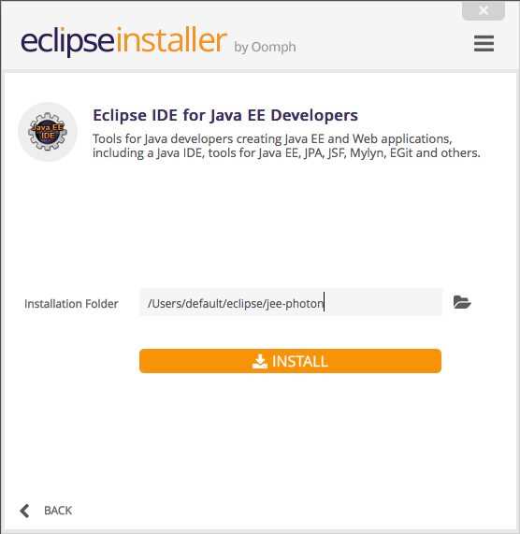
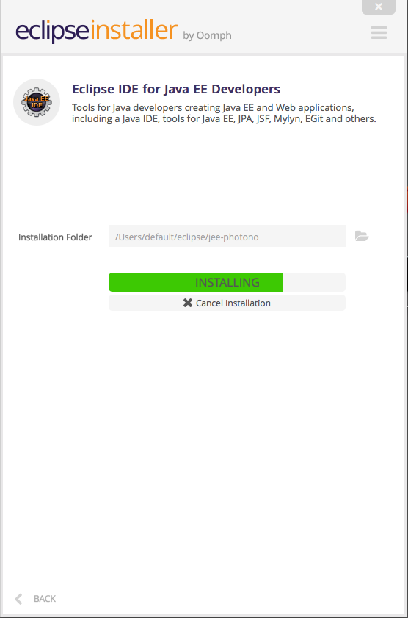
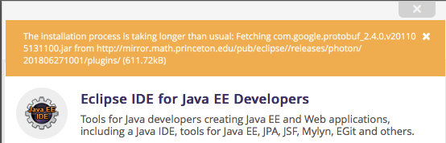
Eclipse Install: Spurious Errors
Notes:
You may receive spurious download errors; either click through, or on complete failure, restart.

Slide 5
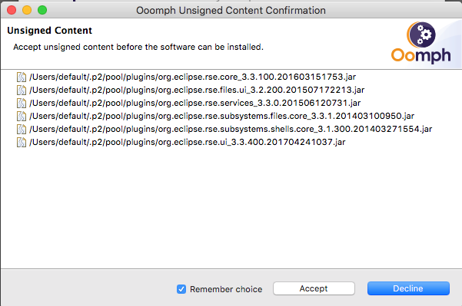
Eclipse Install: Accept Licenses
Notes:
Accept any licenses or similar as they appear.

Slide 6
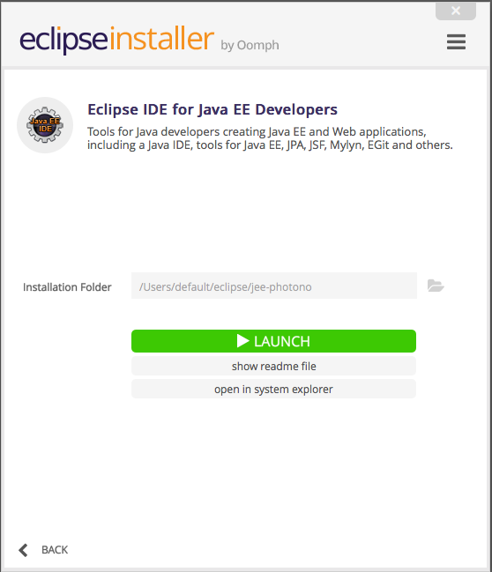
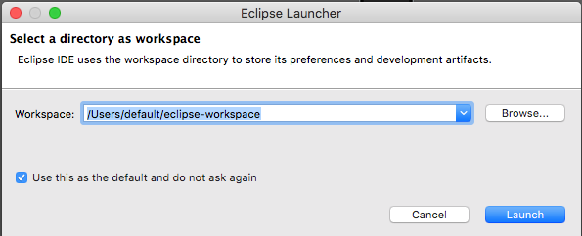
Eclipse: Launch, and Workspace
Notes:
Post install, Eclipse will automatically open the "Launch" dialog box. Click, "Install".
On launch, you are prompted to select a workspace
In simplest contents, a workspace is a parent directory on disk where source code and other related project assets are kept.
In advanced configurations, a workspace will pull from an online, versioned repository like GitHub, or similar.

Slide 7
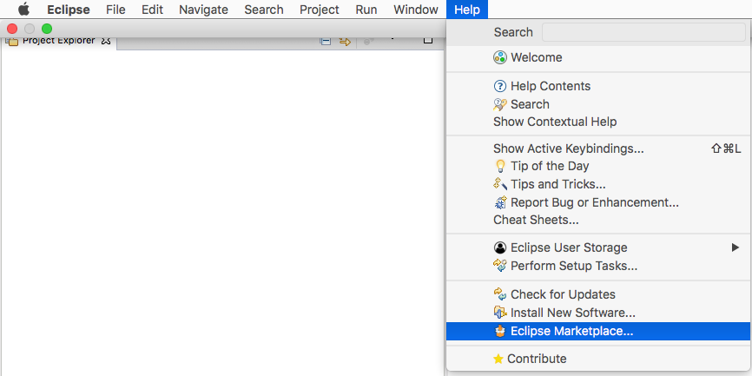
Eclipse: Install Scala plugin
Notes:
Complete the following:
When using DSE Analytics (Apache Spark), we may write in Scala, and need to add to Eclipse in order to support same.
From the Eclipse menu bar select, Help -> Eclipse Marketplace

Slide 8
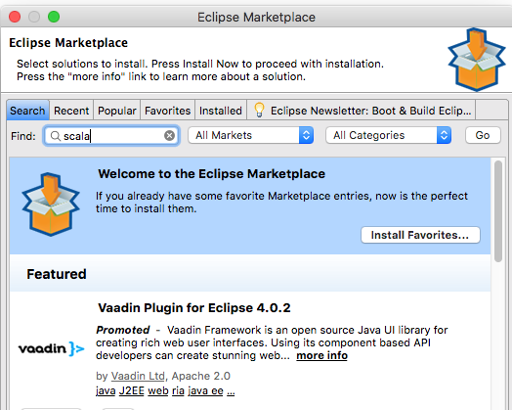
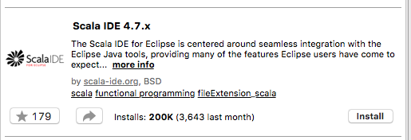
Eclipse: Adding Scala IDE 4.7.x
Notes:
Complete the following:
In the Eclipse Marketplace modal dialog box, enter "scala" in the "Find" text entry field, and Click, Go.
From the listings that are produced, select the "Scala IDE 4.7.x" Eclipse plugin. This plugin supports Scala 2.11 and 2.12, as is our intent.
Click, Install.

Slide 9
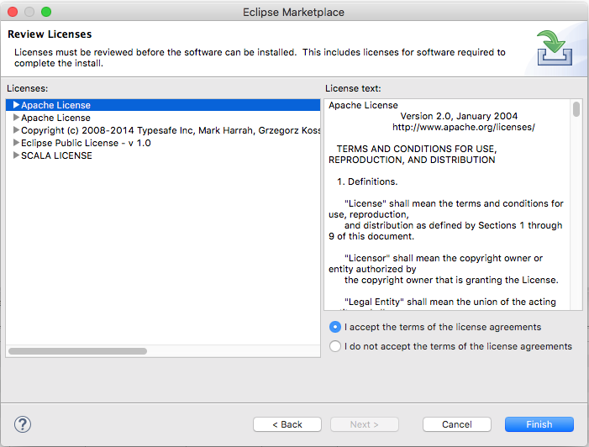
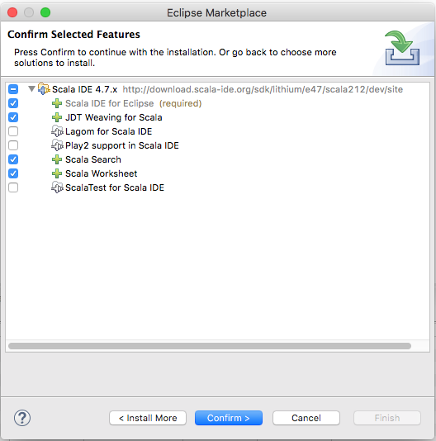
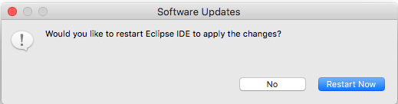
Eclipse Install: Accept Licenses
Notes:
Complete the following:
Click, Confirm, "I accept", and Finish, and Restart Now.

Slide 10
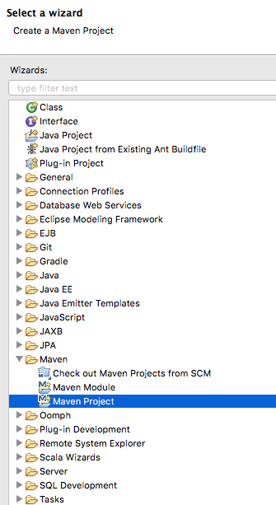
Eclipse: First Steps
Close the Welcome View (and uncheck that you want to see this view next time)
In the upper left, Click to make current the "Project Explorer" view
Right-Click on whitespace in this view, and select New -> Other
This action produces the modal dialog box on the right.
Select Maven -> Maven Project -> Next
Notes:
Complete the following:
Close the Welcome View
In the upper left portion of the display is a TAB (Eclipse View) titled, Project Explorer. If Project Explorer is not in the foreground, Click its title TAB to make it so.
On an area of whitespace in the Project Explorer view, Right-Click, and select, New –> Other
This action produces the "Select a Wizard" modal dialog box as shown
Select, Maven -> Maven Project

Slide 11
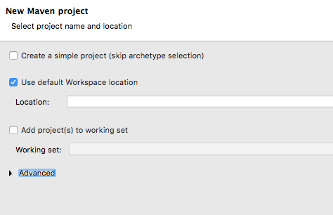
Eclipse: New Maven Project
Notes:
Complete the following:
On the "New Maven project" modal dialog box, not changes are required; just click through-

Slide 12
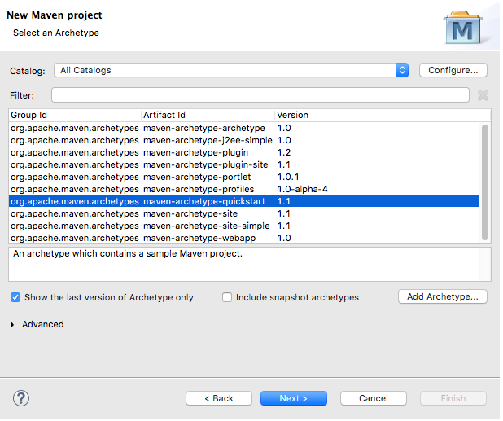
Eclipse: Maven (Project type)
Maven archetypes are essentially (project templates)
Select " .. QuickStart", and Click, Next
Notes:
Complete the following:
Maven archetypes are essentially (project templates). Select " .. QuickStart", and Click, Next.
Reference Urls,
https://maven.apache.org/guides/introduction/introduction-to-archetypes.html

Slide 13
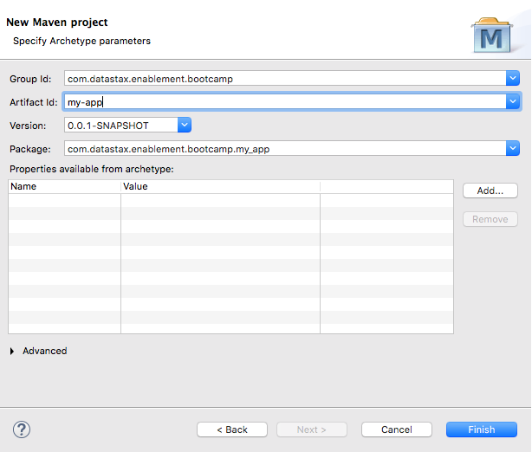

Notes:
Complete the following:
The "Group id" will become the Java package name in our Java sourcxe code file. We entered, "com.datastax.enablment.bootcamp".
The "Artifact id" will become our Java project name, and is a value we will use to run our source code.
And Click, Finish

Slide 14
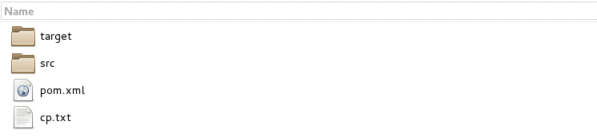







Eclipse: What just happened ?
Group id=com.datastax.enablement.bootcamp
Notes:
Eclipse just generated an entire project filesystem structure, from the current working directory (the workspace), including stubs/other for unit testing, etcetera. Eclipse also generated two specific artifacts of greater interest:
A pom.xml, see pages that follow
An App.java, see pages that follow
The full pathname to our (App.java) was generated from the "groupId" on a prior page

Slide 15
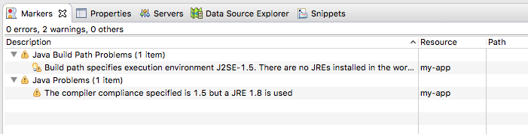
Eclipse: Problem w/ Compiler Version
Notes:
Complete the following:
By default (with this version of Eclipse), the Java compiler version is 1.5. DSE client programs require JCK version 1.8, and we need to make that change.

Slide 16
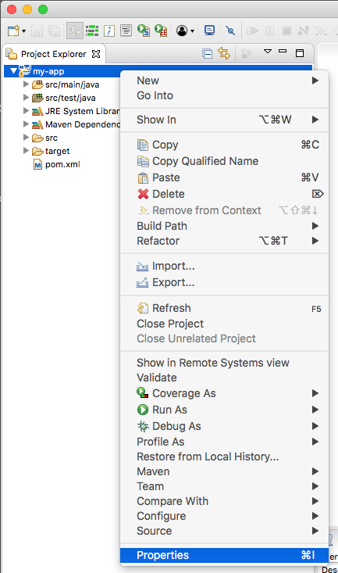
Eclipse: Changing Compiler Version-
In the Project Explorer view, Right-Click the project name (my-app)
And select, Properties
Notes:
Complete the following:
In the Project Explorer view, Right-Click the project name (my-app)
And select, Properties

Slide 17
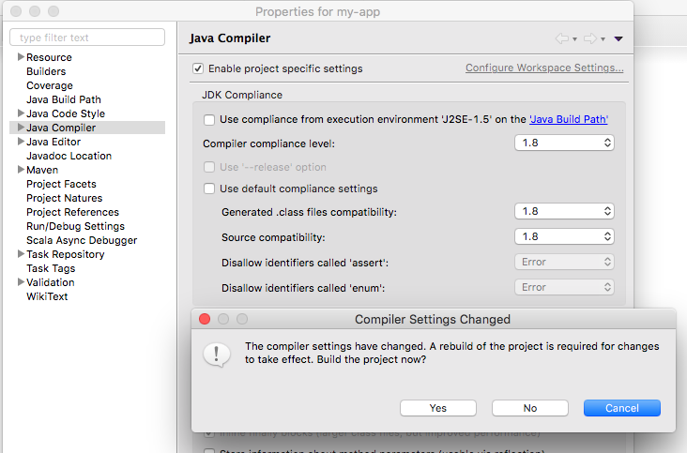
Eclipse: Version 1.8 JDK
Notes:
Complete the following:
In the Properties modal dialog box, navigate to, Java Compiler
Uncheck "Use compliance form execution environment ..."
And uncheck, "Use default compliance settings"
Three drop down list box values are set to "1.5", change those to "1.8".
Click, Apply and Close, and then Click, Yes.

Slide 18
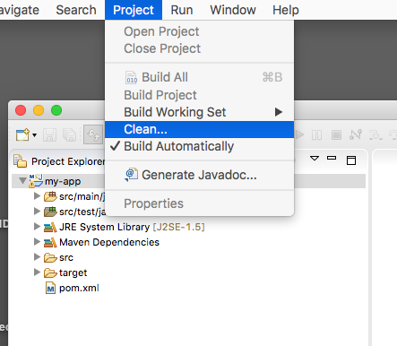
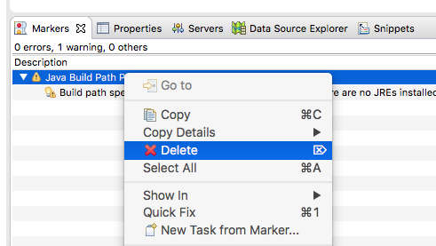
Eclipse: Clean, and (clean)
Notes:
Complete the following:
Changing the Java compiler version is a pretty big deal, since it greatly impacts a number of generated artifacts.
From the Eclipse Menu Bar, select, Project -> Clean, and follow prompts to clean all projects
Also, in the Markers view, Right-Click and Delete any (now old, spurious) error messages.

Slide 19
Ready to Program Java and a DSE Client
Notes:
At this point, Eclipse is installed, configured, and ready for use.

Slide 20
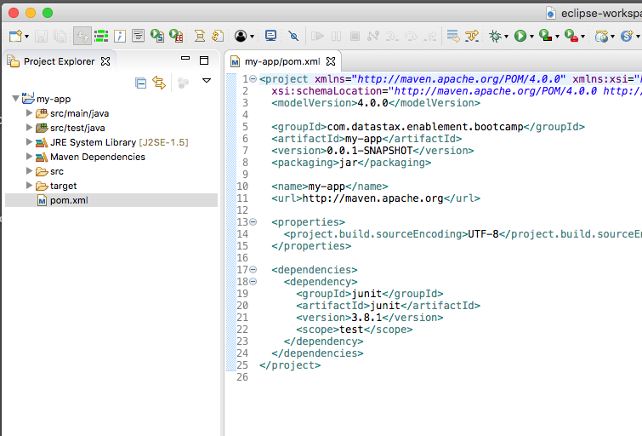
Project Explorer view, pom.xml
Notes:
Complete the following:
In the Project Explorer view, Double-Click the pom.xml file to open it in the Editor view.

Slide 21
What is a pom.xml ?
<project xmlns="http://maven.apache.or ...
xsi:schemaLocation="http://mav ...
<modelVersion>4.0.0</modelVersion>
<groupId>com.datastax.enablement.bootcamp</groupId>
<artifactId>my-app</artifactId>
<packaging>jar</packaging>
<version>1.0-SNAPSHOT</version>
<name>my-app</name>
<url>http://maven.apache.org</url>
<dependencies>
<dependency>
<groupId>junit</groupId>
<artifactId>junit</artifactId>
<version>3.8.1</version>
<scope>test</scope>
</dependency>
</dependencies>
</project>
xml
"project object model"
Each project has one
Tells Maven how to compile, etc, your project
Edit once and done ?
Notes:
The contents of pom.xml are displayed. Comments:
While XML formatted, the (syntax of a POM) is far reaching, and can become complex for true enterprise projects.
We will, in this unit, cover most aspects of a POM relative to compiling DSE Java client programs.

Slide 22
A POM that supports DSE/Java-
Full/complete POM pasted below on Notes page
But in effect, only need this/additional "dependency" block
Jar files pulled, by default, from an online Maven repository
Also pulls whatever Jars these Jars need, etc
This repository can be (should be) internal for real/production apps
<dependencies>
<dependency>
<groupId>com.datastax.dse</groupId>
<artifactId>dse-java-driver-core</artifactId>
<version>1.6.7</version>
</dependency>
</dependencies?
Notes:
A full working POM file is pasted below-
<project xmlns="http://maven.apache.org/POM/4.0.0" xmlns:xsi="http://www.w3.org/2001/XMLSchema-instance"
xsi:schemaLocation="http://maven.apache.org/POM/4.0.0 http://maven.apache.org/maven-v4_0_0.xsd">
<modelVersion>4.0.0</modelVersion>
<groupId>com.datastax.enablement.bootcamp</groupId>
<artifactId>my-app</artifactId>
<packaging>jar</packaging>
<version>1.0-SNAPSHOT</version>
<name>my-app</name>
<url>http://maven.apache.org</url>
<dependencies>
<dependency>
<groupId>com.datastax.dse</groupId>
<artifactId>dse-java-driver-core</artifactId>
<version>1.6.7</version>
</dependency>
<dependency>
<groupId>junit</groupId>
<artifactId>junit</artifactId>
<version>3.8.1</version>
<scope>test</scope>
</dependency>
</dependencies>
</project>

Slide 23
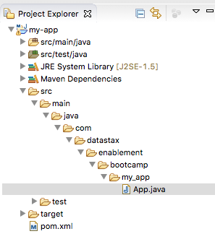
Changing App.java
In the Project Explorer view, navigate to App.java, and Double-Click to open this file in the Editor view
Notes:
Complete the following:
In the Project Explorer view, navigate to App.java, and Double-Click to open this file in the Editor view

Slide 24
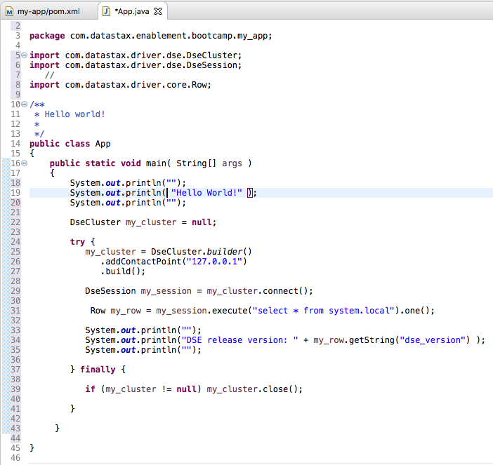
Changing App.java
In the Editor view, change App.java to equal the source code pasted on the Notes page below.
Notes:
package com.datastax.enablement.bootcamp;
import com.datastax.driver.dse.DseCluster;
import com.datastax.driver.dse.DseSession;
//
import com.datastax.driver.core.Row;
//
import com.datastax.driver.core.Cluster;
import com.datastax.driver.core.Host;
import com.datastax.driver.core.Metadata;
//
import com.datastax.driver.core.Session;
//
import com.datastax.driver.core.QueryTrace;
import com.datastax.driver.core.ResultSet;
import com.datastax.driver.core.Row;
import com.datastax.driver.core.SimpleStatement;
//
import java.text.SimpleDateFormat;
//
import com.datastax.driver.core.BoundStatement;
import com.datastax.driver.core.PreparedStatement;
//
import com.datastax.driver.core.BatchStatement;
//
import com.datastax.driver.core.querybuilder.BuiltStatement;
import com.datastax.driver.core.querybuilder.QueryBuilder;
import static com.datastax.driver.core.querybuilder.QueryBuilder.eq;
//
import java.util.Arrays;
import java.util.List;
public class App
{
public static void main( String[] args )
{
System.out.println("");
System.out.println( "Hello World!" );
System.out.println("");
DseCluster my_cluster = null;
try {
// ------------------------------------------
my_cluster = DseCluster.builder()
.addContactPoint("127.0.0.1")
// .withCredentials("guest", "password")
.build();
DseSession my_session1 = my_cluster.connect();
Row my_row1 = my_session1.execute("select * from system.local").one();
System.out.println("");
System.out.println("DSE release version: " + my_row1.getString("dse_version") );
System.out.println("");
// ------------------------------------------
System.out.println("");
Metadata my_metadata1 = my_cluster.getMetadata();
System.out.printf("Connected to cluster: %s %s\n",
my_metadata1.getClusterName(), my_cluster.getClusterName());
for (Host host : my_metadata1.getAllHosts()) {
System.out.printf("Data Center: %s; Rack: %s; Host: %s\n",
host.getDatacenter(), host.getRack(), host.getAddress());
}
System.out.printf("Protocol Version: %s\n",
my_cluster.getConfiguration()
.getProtocolOptions()
.getProtocolVersion());
System.out.println("");
// ------------------------------------------
System.out.println("");
Session.State my_state = my_session1.getState();
System.out.printf("New session created for keyspace: %s\n",
my_session1.getLoggedKeyspace());
for (Host host : my_state.getConnectedHosts()) {
System.out.printf("Data Center: %s; Rack: %s; Host: %s; Open Connections: %s\n",
host.getDatacenter(), host.getRack(), host.getAddress(),
my_state.getOpenConnections(host));
}
System.out.println("");
// ------------------------------------------
// Table made via CQLSH previously,
//
// CREATE TABLE ks_6240.cust_orders
// (
// region TEXT,
// cust_name TEXT,
// ord_num INT,
// other TEXT,
// PRIMARY KEY ((region, cust_name), ord_num)
// );
System.out.println("");
Session my_session2 = my_cluster.connect("ks_6240");
String my_str1 = "JC Penney";
SimpleStatement my_insert1 = new SimpleStatement(
"INSERT INTO cust_orders (region, cust_name, ord_num, other) VALUES (?, ?, ?, ?)",
"NA", my_str1, 109, "Ball, Mitt");
ResultSet my_result1 = my_session2.execute(my_insert1);
System.out.println(my_result1);
System.out.println(my_result1.wasApplied());
System.out.println(my_result1.getExecutionInfo());
System.out.println(my_result1.getExecutionInfo().getIncomingPayload());
SimpleStatement my_select1 = new SimpleStatement(
"SELECT * FROM cust_orders WHERE region = ? AND cust_name = ?",
"NA", my_str1);
my_select1.enableTracing();
ResultSet my_result2 = my_session2.execute(my_select1);
System.out.println(my_result2);
System.out.println(my_result2.wasApplied());
System.out.println(my_result2.getExecutionInfo());
System.out.println(my_result2.getExecutionInfo().getIncomingPayload());
System.out.println(my_result2.getExecutionInfo().getQueryTrace());
for (Row row : my_result2) {
System.out.format("region: %s, cust_name: %s, ord_num: %s, other: %s\n\n",
row.getString("region"), row.getString("cust_name"),
row.getInt("ord_num"), row.getString("other") );
}
SimpleDateFormat my_dateFormat = new SimpleDateFormat("HH:mm:ss.SSS");
//
QueryTrace my_queryTrace1 = my_result2.getExecutionInfo().getQueryTrace();
//
System.out.printf("Trace id: %s\n\n", my_queryTrace1.getTraceId());
System.out.printf("%-42s | %-12s | %-10s \n", "activity",
"timestamp", "source");
//
System.out.println("-------------------------------------------+--------------+------------");
//
for (QueryTrace.Event event : my_queryTrace1.getEvents()) {
System.out.printf("%42s | %12s | %10s\n",
event.getDescription(),
my_dateFormat.format((event.getTimestamp())),
event.getSource());
}
System.out.println("");
// ------------------------------------------
// Table made via CQLSH previously,
//
// CREATE TABLE ks_6240.cust_orders
// (
// region TEXT,
// cust_name TEXT,
// ord_num INT,
// other TEXT,
// PRIMARY KEY ((region, cust_name), ord_num)
// );
System.out.println("");
String my_str2 ="Woolworth's";
PreparedStatement my_prepared1 = my_session2.prepare(
"INSERT INTO cust_orders (region, cust_name, ord_num, other) VALUES (?, ?, ?, ?)");
BoundStatement my_bound1 = my_prepared1.bind(
"NA", my_str2, 110, "Robot, Car");
ResultSet my_result3 = my_session2.execute(my_bound1);
System.out.println(my_result3);
System.out.println(my_result3.wasApplied());
System.out.println(my_result3.getExecutionInfo());
System.out.println(my_result3.getExecutionInfo().getIncomingPayload());
PreparedStatement my_prepared2 = my_session2.prepare(
"SELECT * FROM cust_orders WHERE region = ? AND cust_name = ?");
BoundStatement my_bound2 = my_prepared2.bind("NA", "SEARS");
ResultSet my_result4 = my_session2.execute(my_bound2);
System.out.println(my_result4);
System.out.println(my_result4.wasApplied());
System.out.println(my_result4.getExecutionInfo());
System.out.println(my_result4.getExecutionInfo().getIncomingPayload());
for (Row row : my_result4) {
System.out.format("region: %s, cust_name: %s, ord_num: %s, other: %s\n",
row.getString("region"), row.getString("cust_name"),
row.getInt("ord_num"), row.getString("other"));
}
System.out.println("");
// ------------------------------------------
// Table made via CQLSH previously,
//
// CREATE TABLE ks_6240.cust_orders
// (
// region TEXT,
// cust_name TEXT,
// ord_num INT,
// other TEXT,
// PRIMARY KEY ((region, cust_name), ord_num)
// );
System.out.println("");
SimpleStatement my_delete1 = new SimpleStatement(
"DELETE FROM cust_orders WHERE region = ? AND cust_name= ?", "NA", my_str2);
ResultSet my_result5 = my_session2.execute(my_delete1);
System.out.println(my_result5);
System.out.println(my_result5.wasApplied());
System.out.println(my_result5.getExecutionInfo());
System.out.println("num results: " + my_result5.all().size());
for (Row row : my_result5) {
System.out.format("region: %s, cust_name: %s, ord_num: %s, other: %s\n",
row.getString("region"), row.getString("cust_name"),
row.getInt("ord_num"), row.getString("other"));
}
System.out.println("");
// ------------------------------------------
// Table made via CQLSH previously,
//
// CREATE TABLE ks_6240.cust_orders
// (
// region TEXT,
// cust_name TEXT,
// ord_num INT,
// other TEXT,
// PRIMARY KEY ((region, cust_name), ord_num)
// );
System.out.println("");
SimpleStatement my_insert2 = new SimpleStatement(
"INSERT INTO cust_orders (region, cust_name, ord_num, other) VALUES (?, ?, ?, ?)",
"SA", "X-Store", 101, "Water, Juice");
SimpleStatement my_insert3 = new SimpleStatement(
"INSERT INTO cust_orders (region, cust_name, ord_num, other) VALUES (?, ?, ?, ?)",
"SA", "X-Store", 102, "Water, Juice, Lemons");
BatchStatement my_batch1 = new BatchStatement();
my_batch1.add(my_insert2);
my_batch1.add(my_insert3);
ResultSet my_result6 = my_session2.execute(my_batch1);
System.out.println(my_result6);
System.out.println(my_result6.wasApplied());
System.out.println(my_result6.getExecutionInfo());
System.out.println(my_result6.getExecutionInfo().getIncomingPayload());
System.out.println("");
// ------------------------------------------
// Table made via CQLSH previously,
//
// CREATE TABLE ks_6240.cust_orders
// (
// region TEXT,
// cust_name TEXT,
// ord_num INT,
// other TEXT,
// PRIMARY KEY ((region, cust_name), ord_num)
// );
System.out.println("");
SimpleStatement my_insert4 = new SimpleStatement(
"INSERT INTO cust_orders (region, cust_name, ord_num, other) VALUES (?, ?, ?, ?) IF NOT EXISTS",
"SA", "X-Store", 103, "Water, Juice, Pie");
ResultSet my_result7 = my_session2.execute(my_insert4);
System.out.println(my_result7);
System.out.println(my_result7.wasApplied());
System.out.println(my_result7.getExecutionInfo());
System.out.println(my_result7.getExecutionInfo().getQueryTrace());
for (Row row : my_result7) {
System.out.format("region: %s, cust_name: %s, ord_num: %s, other: %s\n",
row.getString("region"), row.getString("cust_name"),
row.getInt("ord_num"), row.getString("other") );
}
System.out.println("");
// ------------------------------------------
System.out.println("");
Metadata my_metadata2 = my_cluster.getMetadata();
System.out.printf("Connected to cluster: %s %s\n",
my_metadata2.getClusterName(), my_cluster.getClusterName());
System.out.println("Schema:");
System.out.println(my_metadata2.exportSchemaAsString());
System.out.println();
System.out.printf("Schema agreement : %s\n",
my_metadata2.checkSchemaAgreement());
System.out.println("");
// ------------------------------------------
// Table made via CQLSH previously,
//
// CREATE TABLE ks_6240.cust_orders
// (
// region TEXT,
// cust_name TEXT,
// ord_num INT,
// other TEXT,
// PRIMARY KEY ((region, cust_name), ord_num)
// );
System.out.println("");
BuiltStatement my_built1 = QueryBuilder.insertInto("cust_orders").
value("region", "EMEA").
value("cust_name", "Apple").
value("ord_num", 200).
value("other", "mouse");
ResultSet my_result8 = my_session2.execute(my_built1);
System.out.println(my_result8);
System.out.println(my_result8.wasApplied());
System.out.println(my_result8.getExecutionInfo());
System.out.println(my_result8.getExecutionInfo().getIncomingPayload());
// BuiltStatement my_built2 = QueryBuilder.select().all().
// from("cust_orders").where(eq("region", "EMEA"));
// BuiltStatement my_built2 = QueryBuilder.select().all().
// from("cust_orders").where( eq(Arrays.asList("region", "cust_name"), Arrays.asList("EMEA", "Apple")) );
// Above currently throws at RT,
// Exception in thread "main" com.datastax.driver.core.exceptions.InvalidQueryException:
// Multi-column relations can only be applied to clustering columns but was applied to: region
// ResultSet my_result9 = my_session2.execute(my_built2);
// System.out.println(my_result9);
// System.out.println(my_result9.wasApplied());
// System.out.println(my_result9.getExecutionInfo());
// System.out.println(my_result9.getExecutionInfo().getIncomingPayload());
// for (Row row : my_result9) {
// System.out.format("region: %s, cust_name: %s, ord_num: %s, other: %s\n",
// row.getString("region"), row.getString("cust_name"),
// row.getInt("ord_num"), row.getString("other") );
// }
// BuiltStatement my_built3 = QueryBuilder.delete().all().
// from("cust_orders").where( eq(Arrays.asList("region", "cust_name"), Arrays.asList("EMEA", "Apple")) );
// ResultSet my_result10 = my_session2.execute(my_built3);
// System.out.println(my_result10);
// System.out.println(my_result10.wasApplied());
// System.out.println(my_result10.getExecutionInfo());
// System.out.println(my_result10.getExecutionInfo().getIncomingPayload());
// System.out.println("");
// ------------------------------------------
} finally {
if (my_cluster != null) my_cluster.close();
}
}
}

Slide 25
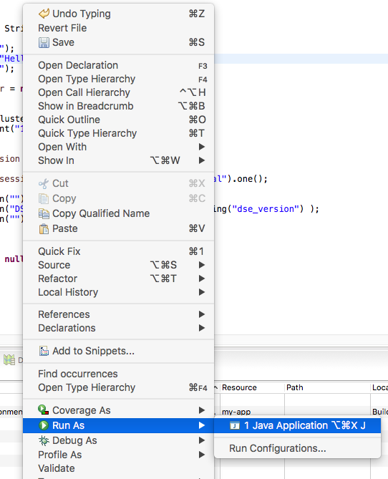
Eclipse: Compile and Run
Anywhere in the Editor view (in App.java), Right-Click and select, Run As -> Java Application
You will be prompted to save the changes you made to pom.xml, and App.java, so save
Notes:
Complete the following:
The

Slide 26
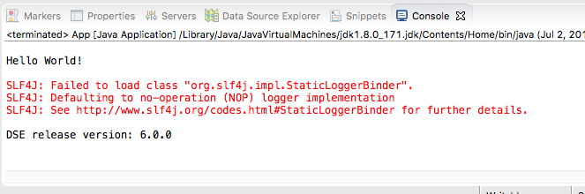
Eclipse: Success
Notes:
Complete the following:
A successful compile and run will appear in the Console view, as our Java program currently writes to Std/out.

Slide 27

Practice Lab:
Lessons Learned
Notes:
Discuss what worked well, poorly, from the Practice Lab.

Slide 28
End of Unit:
Notes:
End of Practice Lab-

